Slide 1
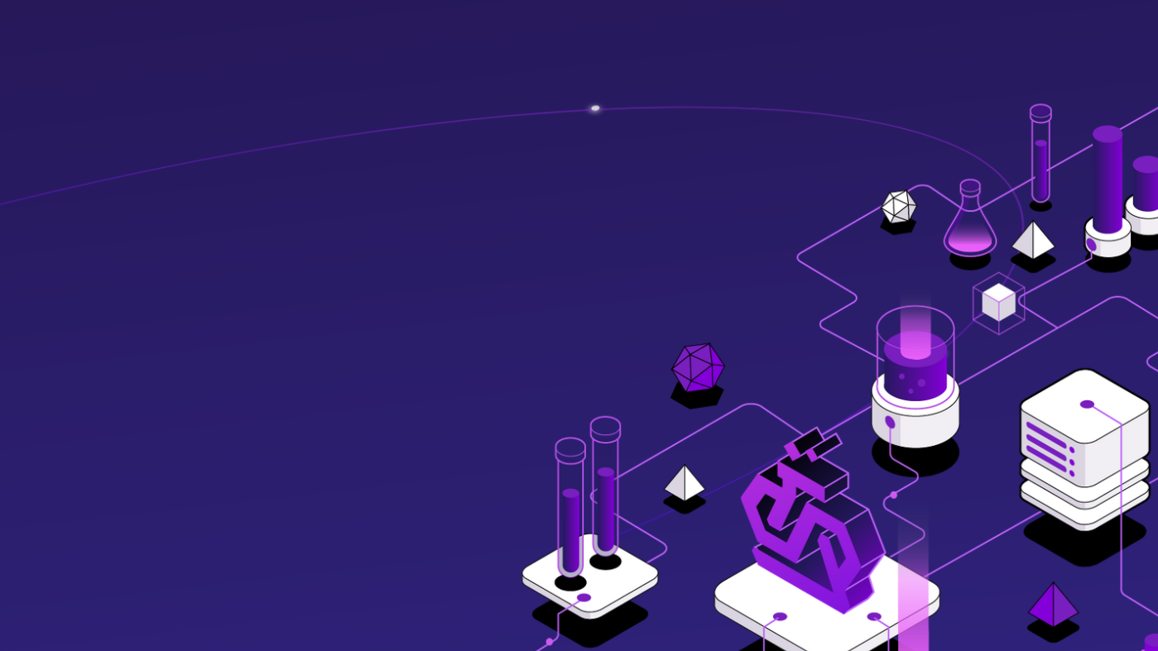
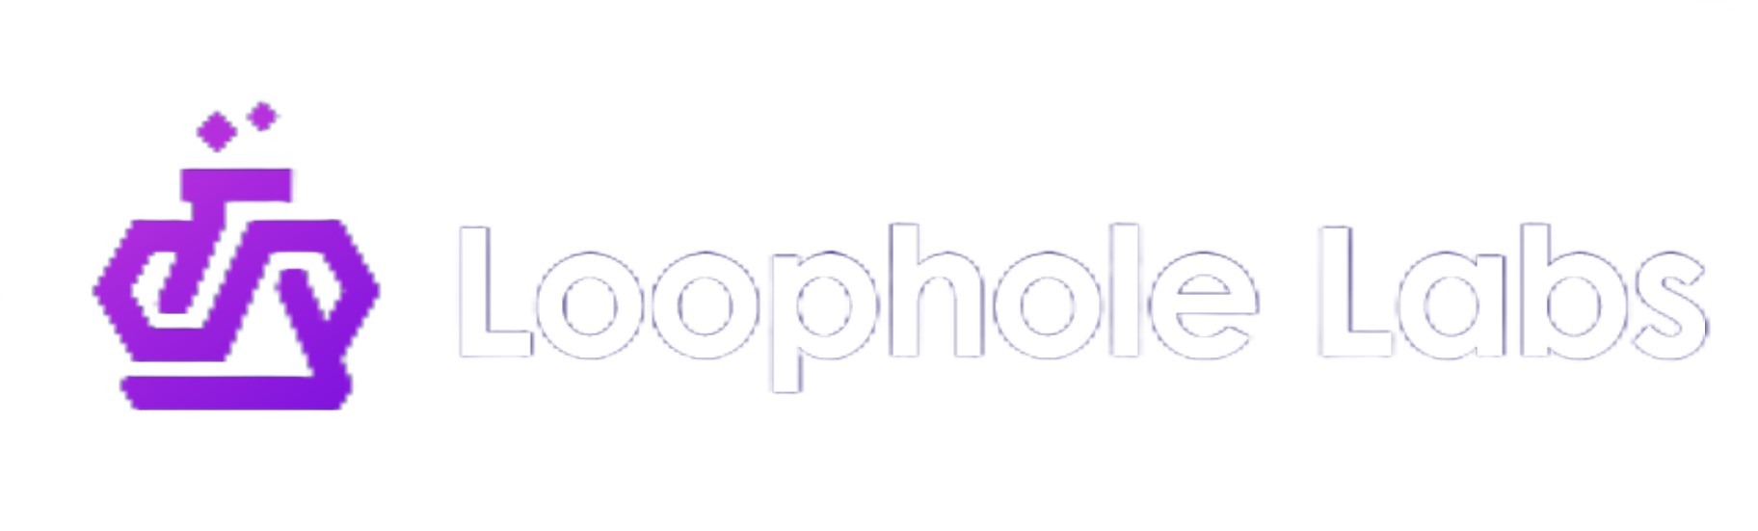
Commoditize Your CI Compute:
Spot Instances Without the Spotty Reliability
Felicitas Pojtinger (maintainer of Drafter)
@pojntfx
Notes:
Hi everyone! I'm Felicitas from Loophole Labs!
We've heard lots of fascinating talks in these past few days about finding bugs, fixing them, and writing more reliable software.
Now let’s take a step back to look at something more fundamental: the actual compute infrastructure that we use to run our CI/CD pipelines.
This is a speedrun – I’m turning a 35-minute talk into an 8 minute talk (with a live demo!) - so buckle up!

Slide 2
Are you running your CI/CD on spot instances?
Notes:
Quick show of hands: Is anyone in here currently running their CI/CD on spot instances? [PAUSE]
Right - and I don't blame you! But doesn’t that seem a bit strange?

Slide 3
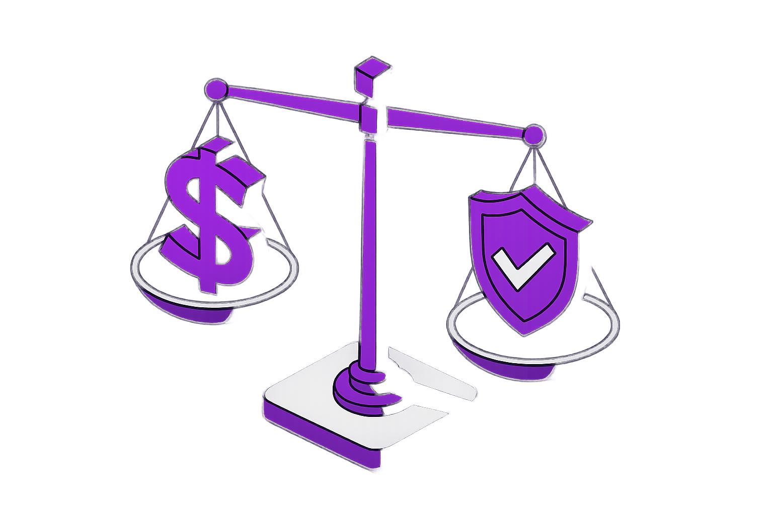
Pay only for what you use
70-90% savings
Better for cloud providers, too
Notes:
Spot instances offer lots of benefits after all:
They save 70-90% of costs compared to on-demand,
you only pay for what you use,
and they’re also more efficient for cloud providers since they can be reclaimed when needed.

Slide 4
30-120s termination notice
Notes:
So then, why aren’t we all using them (except for that guy)?
I’ll tell you why: Termination notices. If I’m running a stateful workload (a long running build, GPU training or an integration test) and I only get 30s notice before my host and all of it’s data gets deleted – that would be catastrophic.

Slide 5
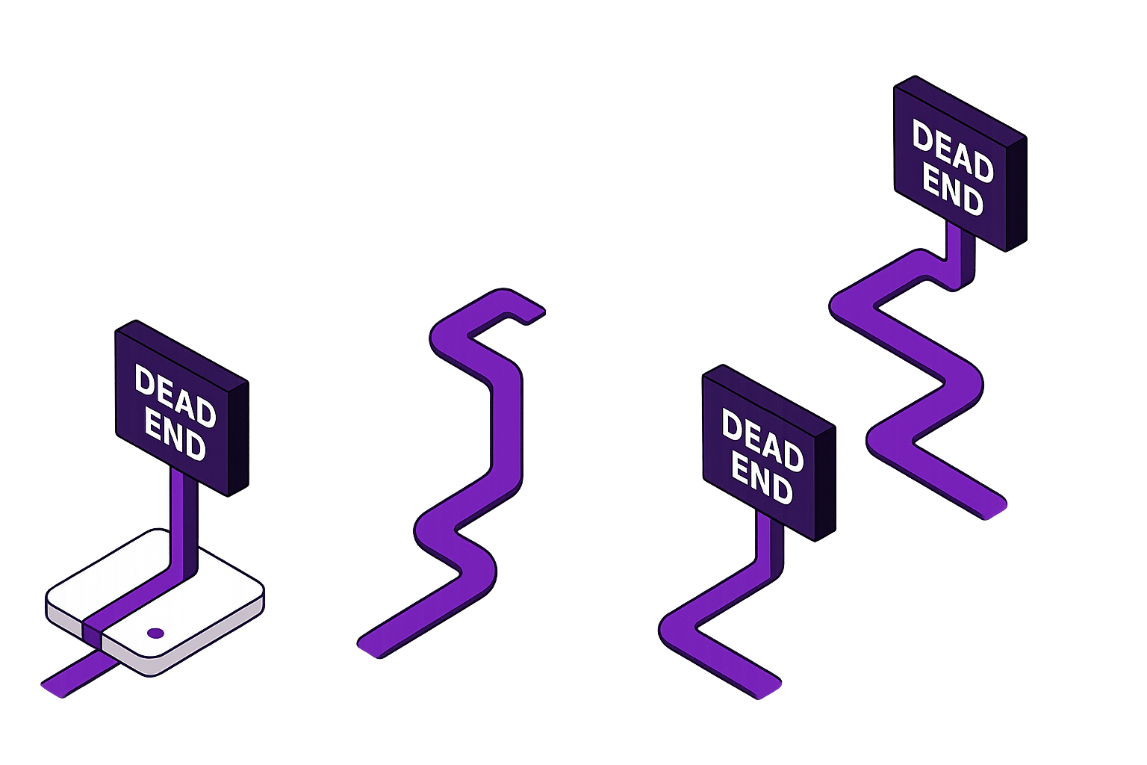
❌ Complex custom checkpointing
❌ Spots only for stateless jobs
❌ Expensive on-demand instances
❌ Accept failures and retry
Notes:
So what do we do if we want reliable spot instances?
Do we limit ourselves to stateless jobs (which aren’t that useful)?
Do we build complex custom checkpointing for each application like the AI people do?
Do we accept failures & retries and make our engineers hate us?
Or do we give up on spot, cry and resign ourselves to overpaying for on-demand instances?

Slide 6
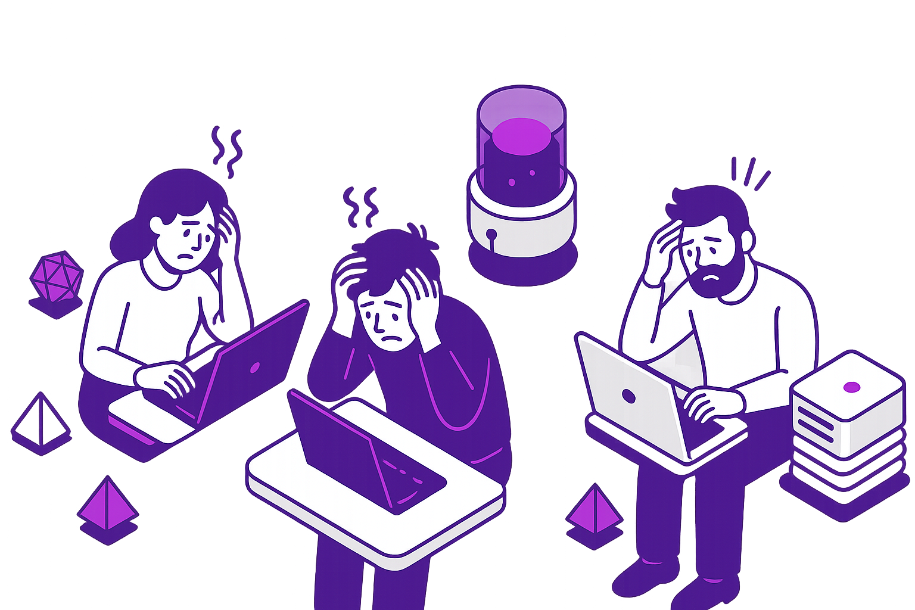
Fewer tests that don’t run for each commit
Short or no benchmarks
No or little fuzzing
€$¥
Notes:
What a mess. We shouldn’t have to do that! We shouldn’t have to waste hundreds of thousands of dollars annually on on-demand instances. Those costs lead to real issues:
We write fewer tests or don’t run them on each commit,
We write short benchmarks or no benchmarks at all
and we can’t even think about fuzzing.

Slide 7
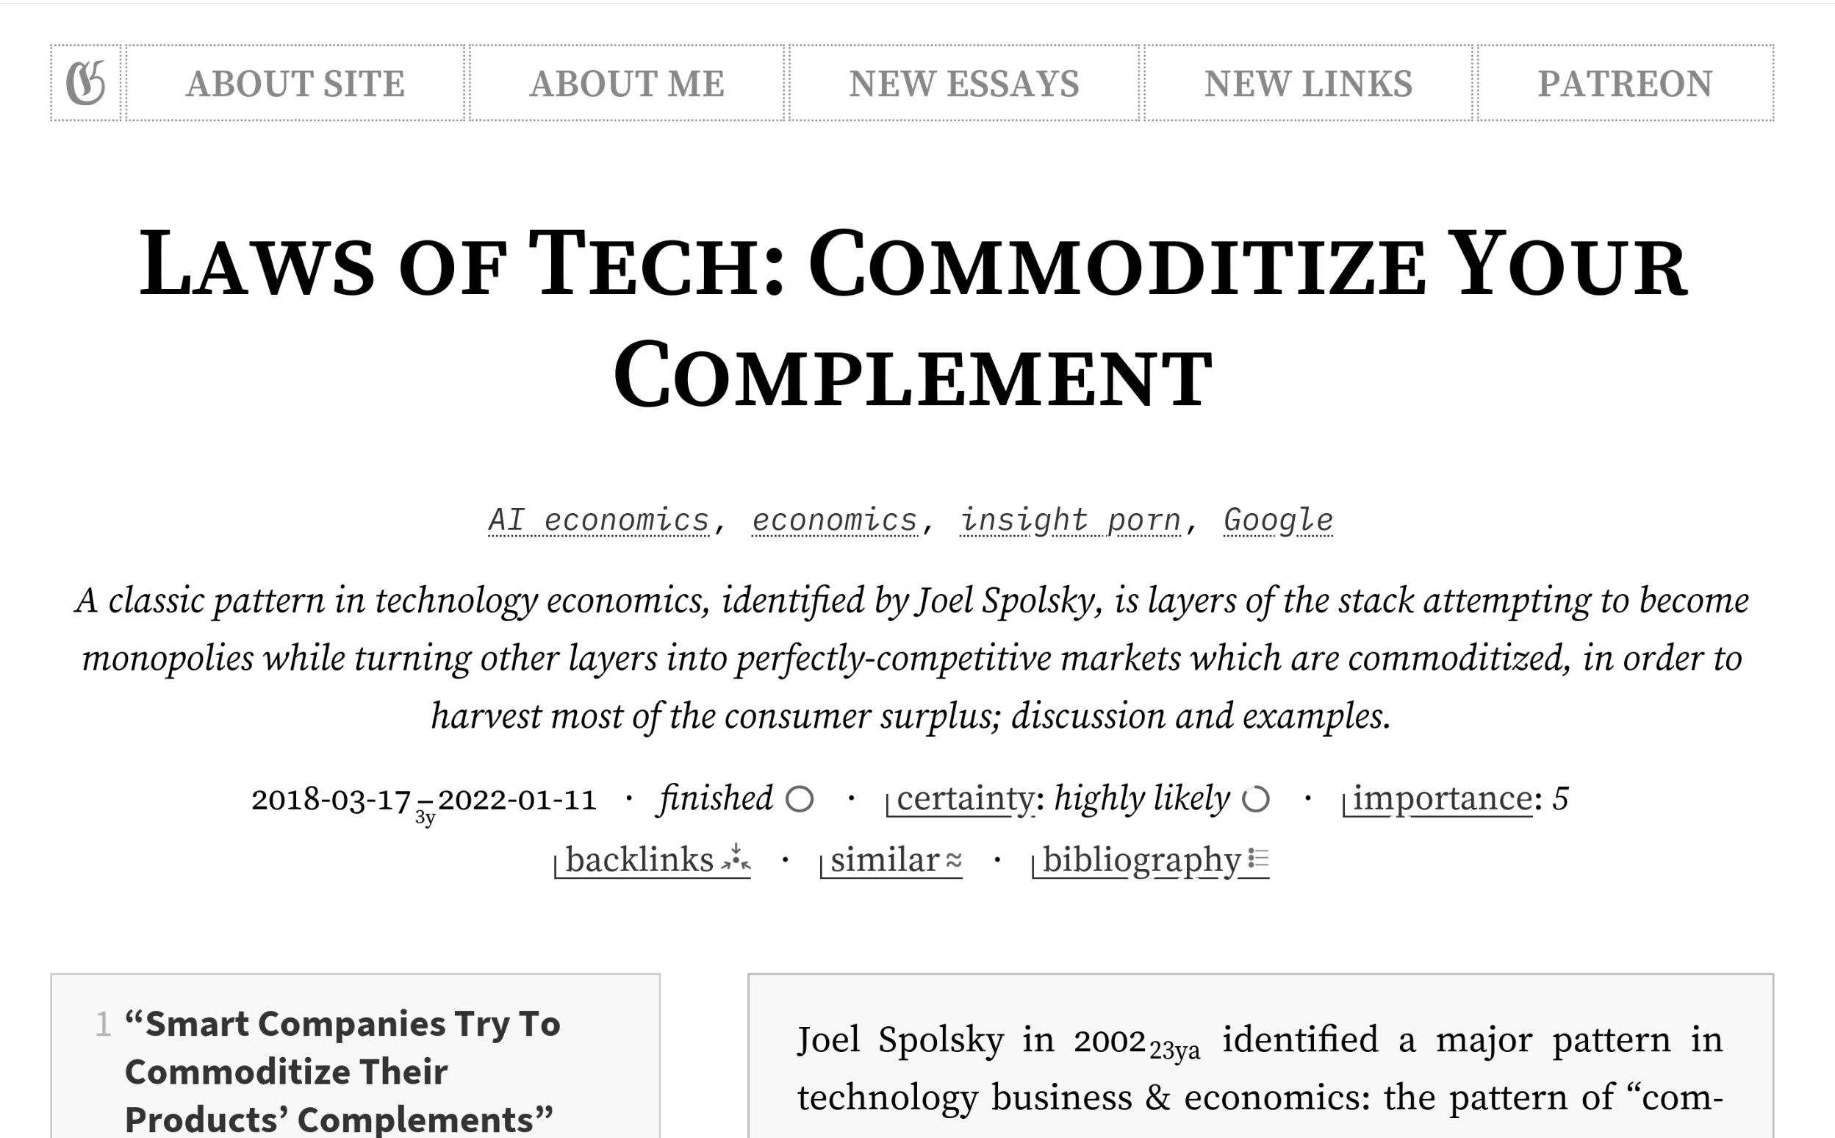
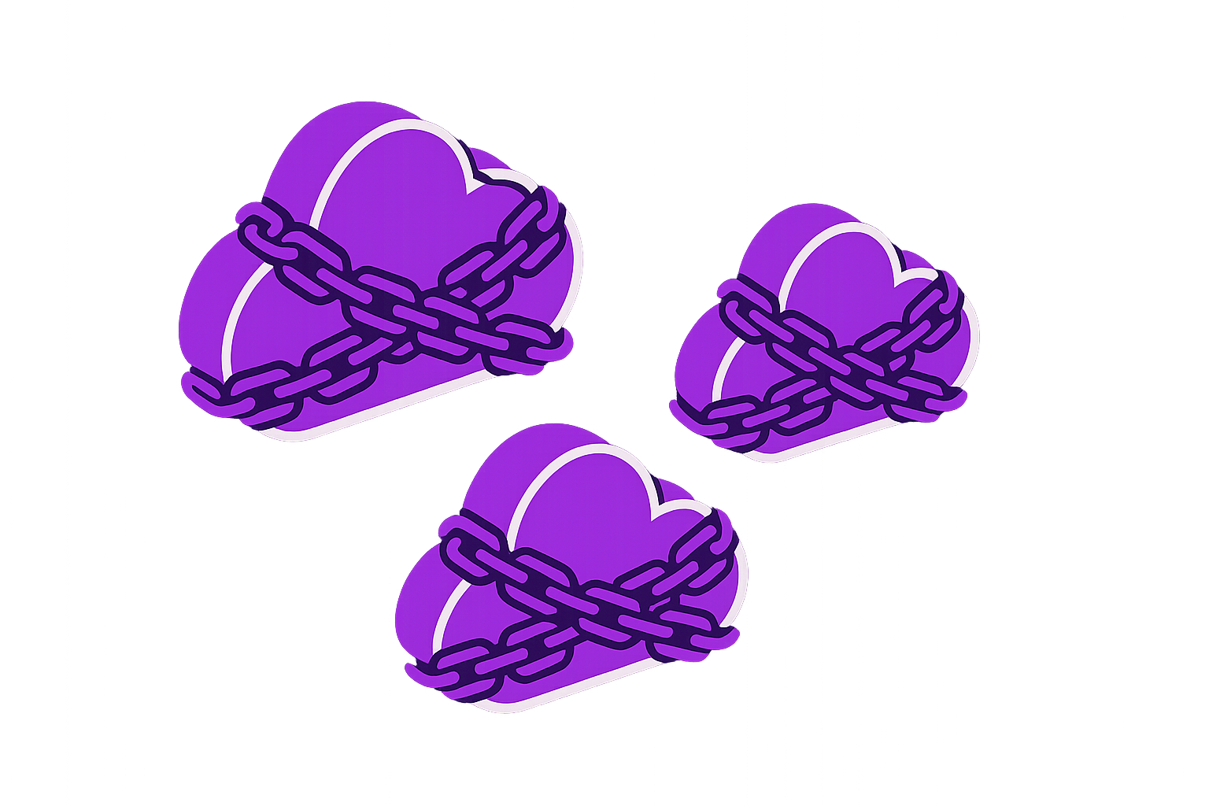
https://gwern.net/complement
Notes:
Not only that, but this goes beyond cost, it's also about digital sovereignty.
Proprietary ecosystems like AWS prevent us from switching between clouds and there's no way to move our workloads between them.
Cloud providers themselves follow the "Law of Complements". They monopolize compute while commoditizing the layers below, but as a client they don’t allow you to do that yourself.

Slide 8
“A unified, failure-proof compute fabric”
Notes:
This is where Architect comes in. [PAUSE]
Architect is a unified failure-proof compute fabric (based on spot instances!) that allows you to commoditize your complement, the cloud provider. [PAUSE]

Slide 9
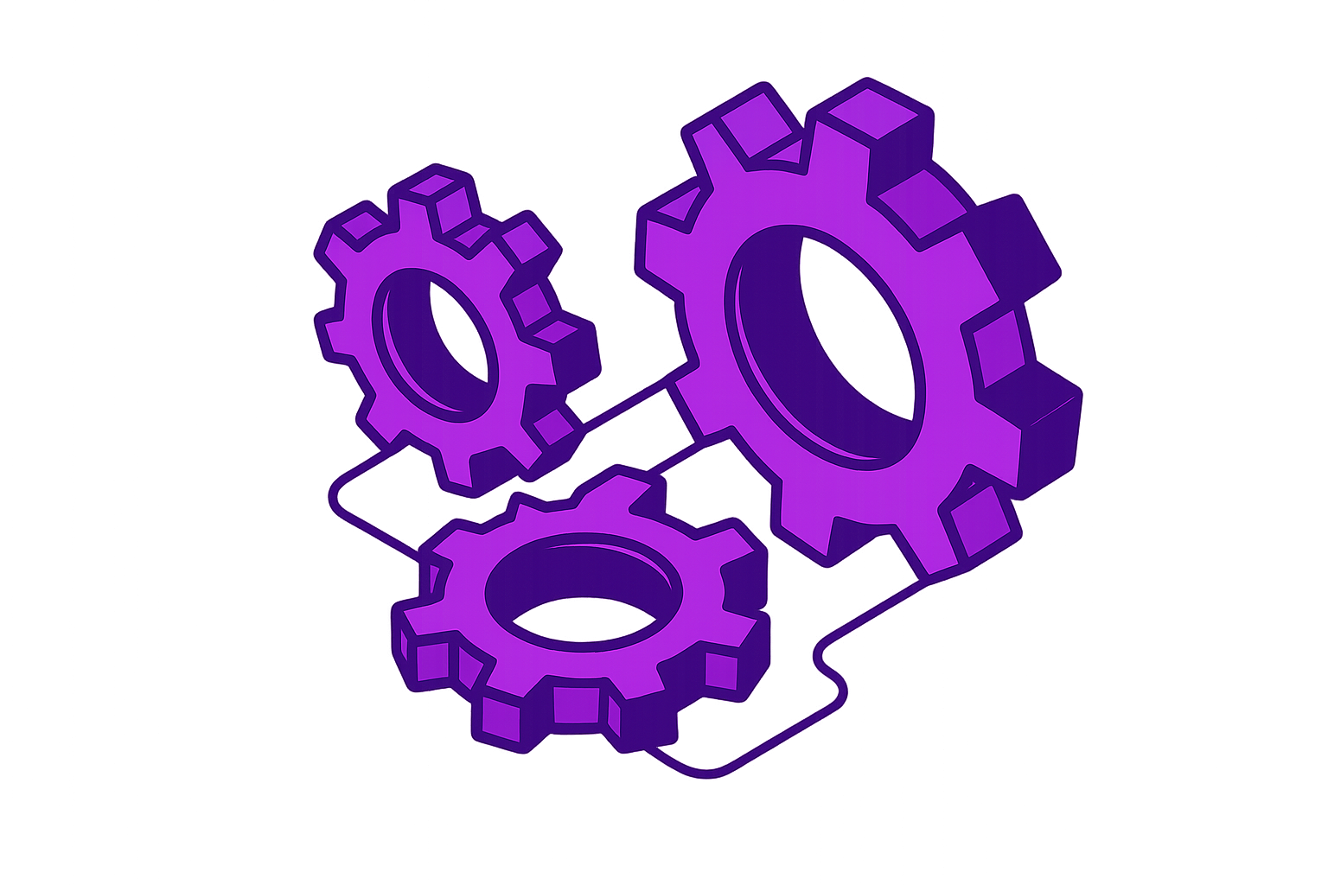
Cloud-agnostic (AWS, GCP, Azure, on-prem etc.) VM images and snapshots
Very fast live migration
Complete compliance
Notes:
Three key concepts make this possible: First, cloud-agnostic VM images and snapshots - we're not replacing VMs with containers. We’re creating actual KVM-based VMs that run everywhere.
Second, quick live migration – quicker than the 30s termination notice, allowing us to use spot instances as if they were on-demand;
and third, complete compliance. All devices you expect in a virtual machine (CPU, GPU, disk and network) will continue to function they way you expect them to with zero code changes to your application.

Slide 10
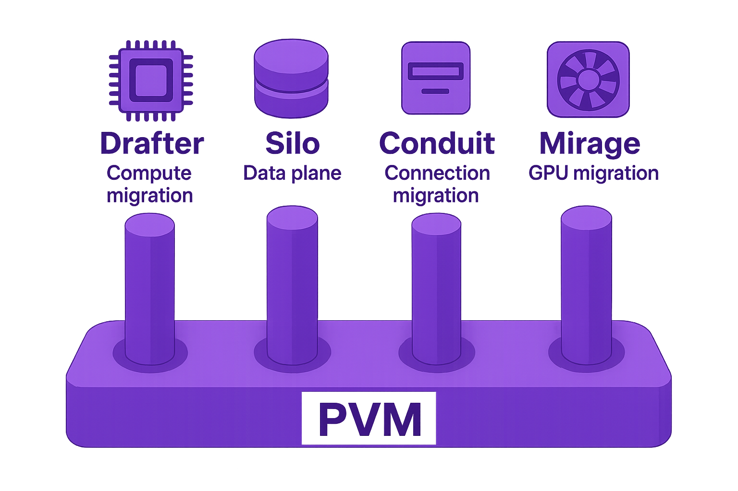
Notes:
And this is the tech stack that makes it all possible: Drafter, Silo, Conduit and Mirage, all powered by PVM. [PAUSE] Let’s dive in!

Slide 11
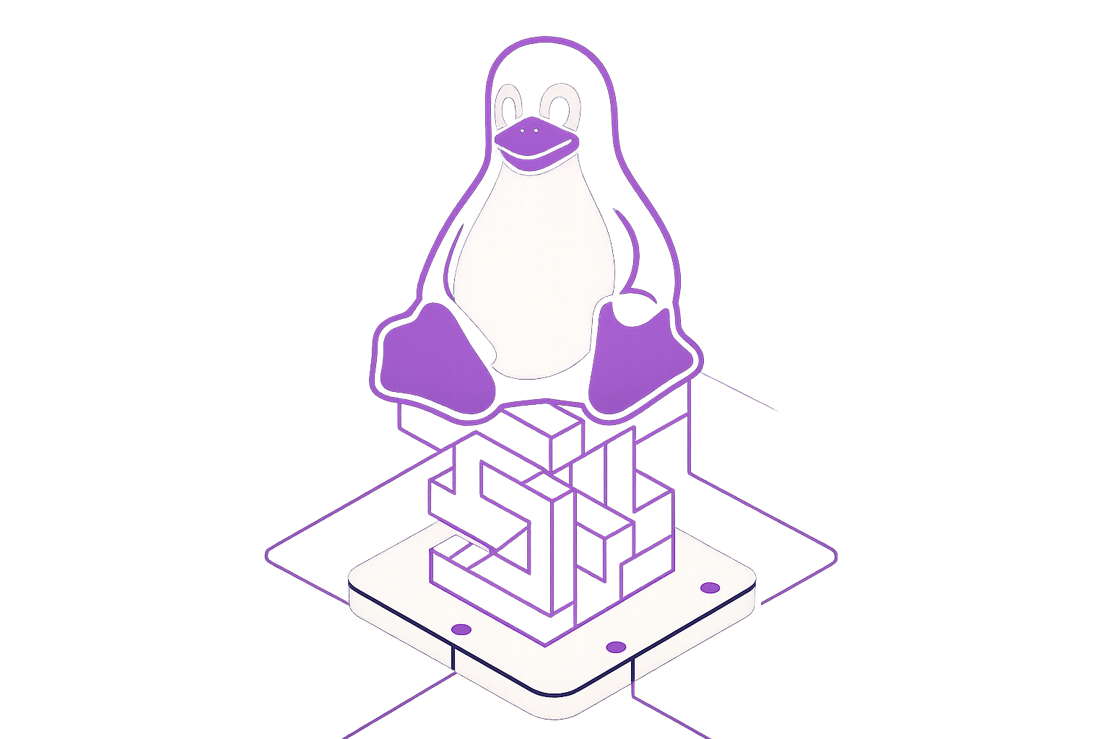
PVM: Pagetable Virtual Machine
Performance overhead <10% compared to host
Run VMs on VMs
without nested virtualization or emulation
Custom Loophole Labs patches for live migration
Notes:
First up – PVM, the Pagetable Virtual Machine.
PVM is a new Linux patchset introduced last year that allows running VMs on top of VMs. [BREATHE]
Unlike nested virtualization, it doesn't need software emulation or bare metal instances. It doesn’t need consent or buy-in from the cloud providers, it works anywhere that we can run Linux.
On top of that, we have created custom PVM patches for live migration that have minimized performance overhead to under 10%.

Slide 12
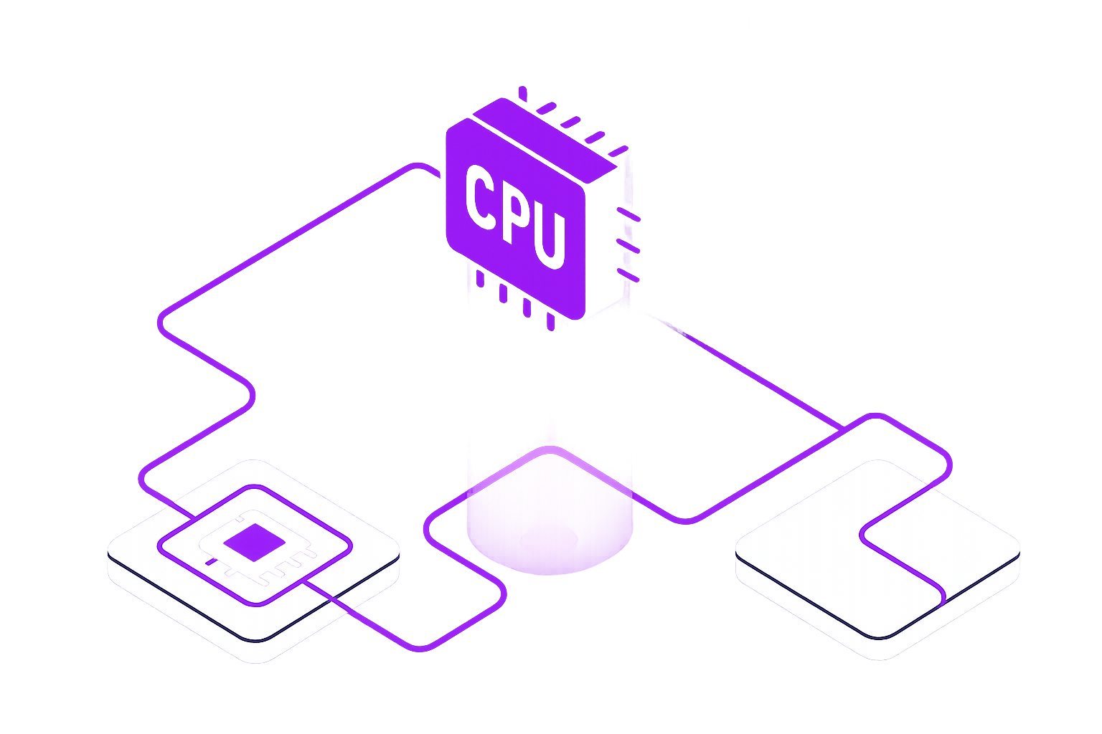
Drafter: Compute Unit
Hypervisor with first-class live migration support
Normalizes CPU feature sets across hosts
Based on our fork of Firecracker
Notes:
Up next is Drafter.
Drafter is our open-source unit of compute with first-class live migration support.
We wrote it in Go and based it on Firecracker, which allows us to normalize CPUs across heterogeneous hosts for safe migrations.
We use our customized Firecracker fork to support continuous tracking of memory changes during runtime.
It’s basically the “core” userspace component of Architect.

Slide 13
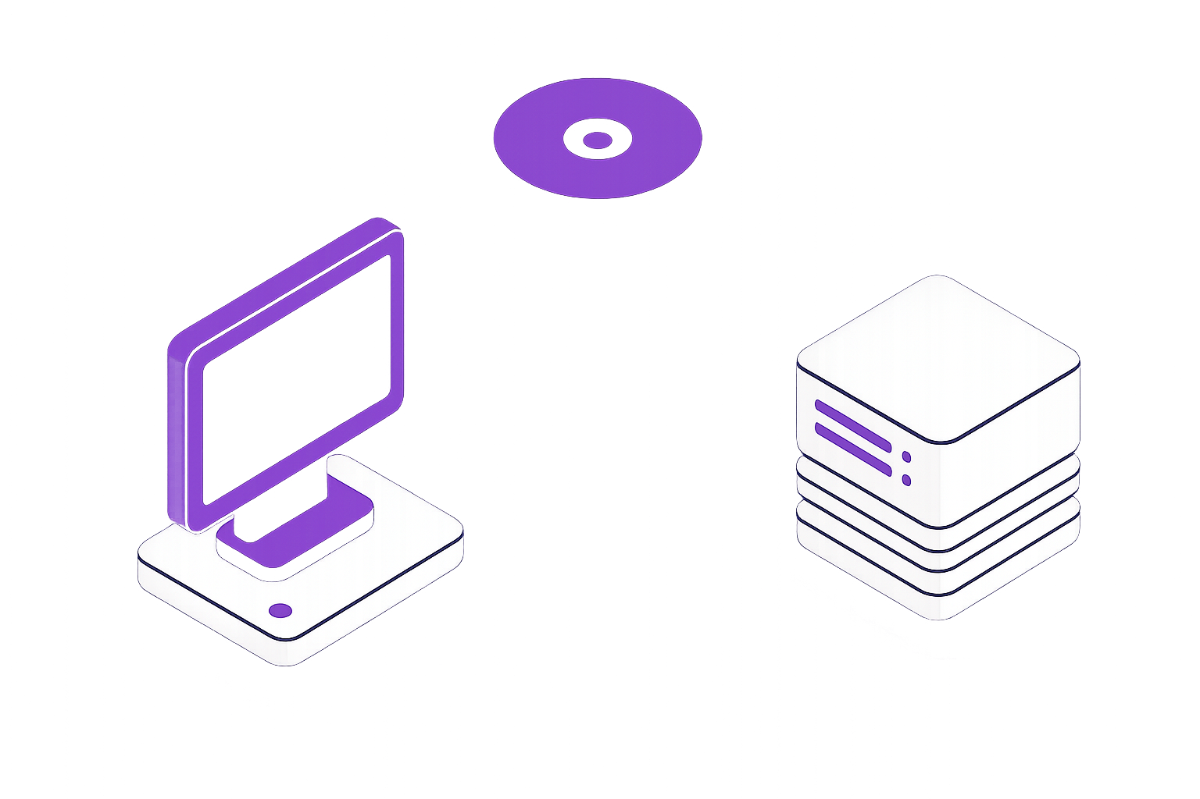
Silo: Data Migration System
Prioritizes important blocks over P2P connection and falls back to S3
Tracks disk & memory changes and learns access patterns
Continuously backs up to S3
Notes:
Next up, Silo.
Silo manages data migration and is also open-source.
It continuously tracks changes to disk and memory in order to learn access patterns.
It then uses them to create continuous backups that are synced to S3 asynchronously while the VM is running. [BREATHE]
During the actual migration, Silo sends the most important chunks (based on the learned patterns) first over a P2P connection. When this is done, it fetches the least important chunks from S3, so that the P2P connection can be closed and the source host shut down ASAP.

Slide 14
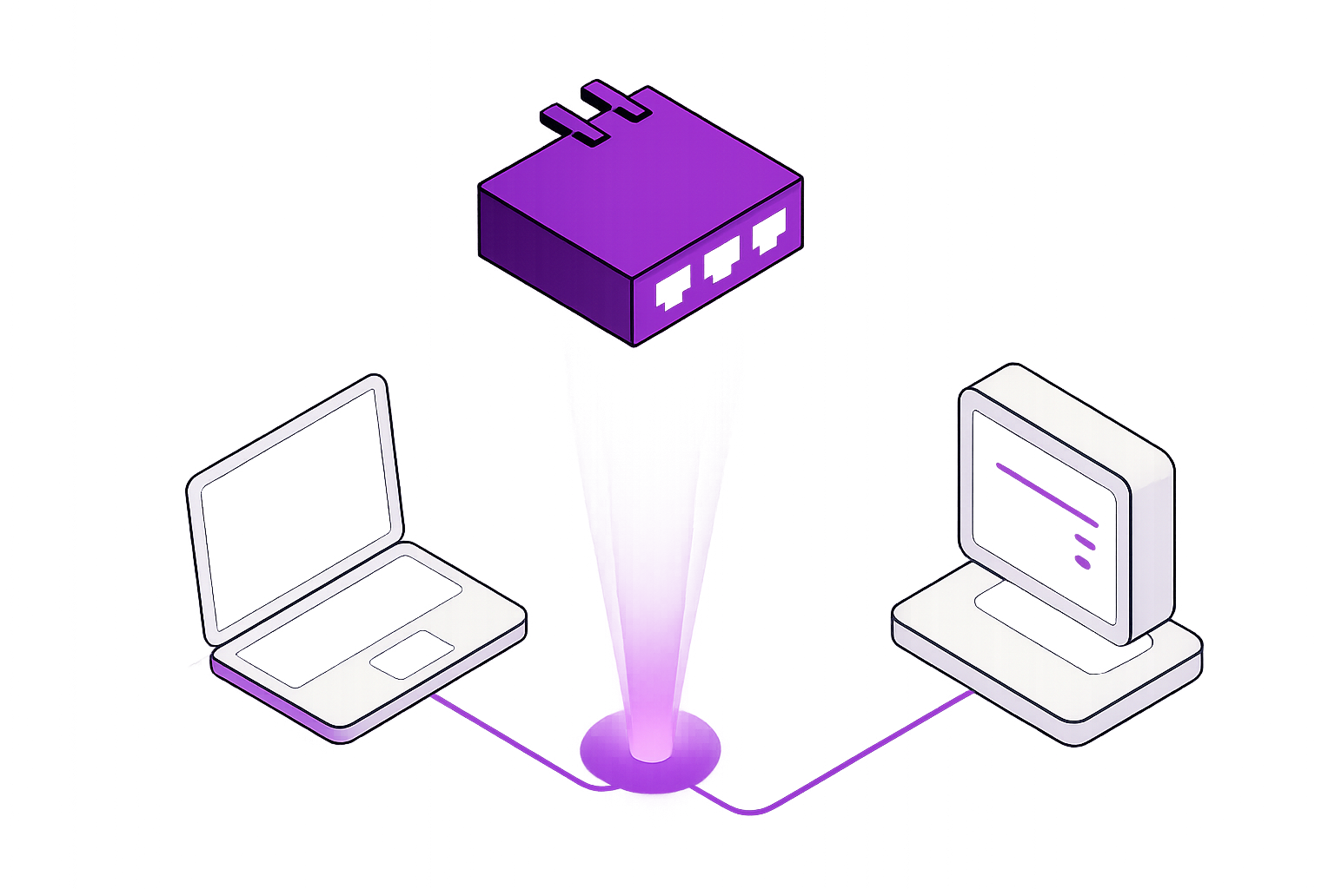
Conduit: Network Migration
Supports migrating ingress & egress traffic
Written in eBPF:
Runs on network card at line speed
Works on L3 (both UDP & TCP are supported)
Notes:
Conduit is next.
After migrating from source to destination, IP addresses change, which usually breaks connections. Conduit solves this problem.
It’s written in eBPF, which means it runs directly on the network card at essentially line speed.
It supports both ingress and egress connection migrations of any layer 3 protocol, so downloads that the guest starts before or during a migration won't be interrupted.
It's a bit out of scope for now, but look out for a QR code at the end for a more in-depth talk on the subject!
With Conduit, you con du it!

Slide 15
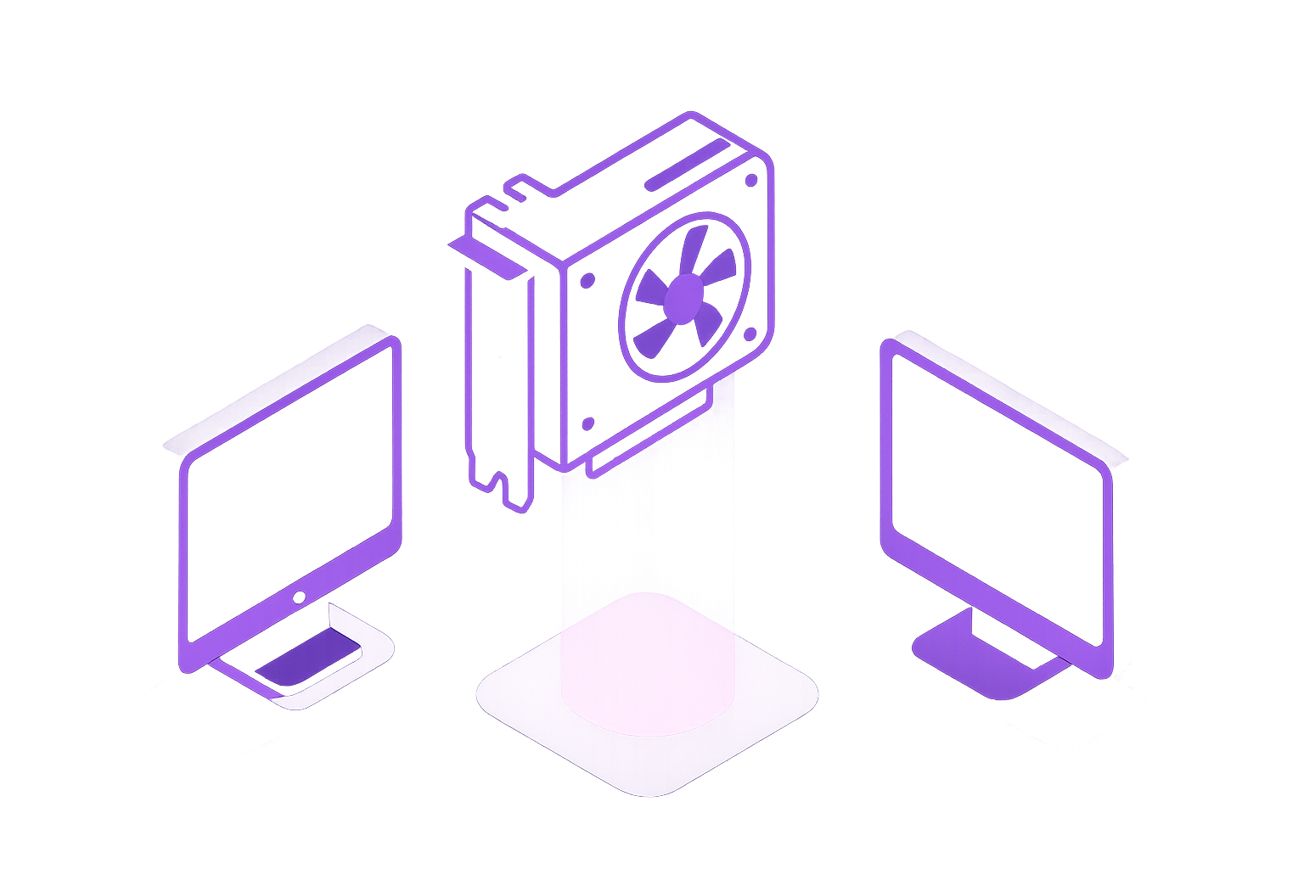
Mirage: GPU Workload Migration
Supports both inference and training
Zero application changes needed
Supports migrating a workload between heterogeneous hosts and GPUs
Notes:
Last but not least, Mirage.
Mirage is an experimental component that enables live migration of GPU workloads.
It's also out of scope for now and still in closed beta, but if you're interested, talk to me afterwards – I don’t bite. [SHORT PAUSE]
It works without any changes to your application,
supports both inference and training,
and can migrate across different types of GPUs.

Slide 16
Notes:
Finally, Architect is what we like to call the "Migration Policy Engine".
It is the orchestrator. [PAUSE]
It conducts all of this [POINT AT SCREEN] while exposing a simple, unified API that ties compute, disk, network and GPU migrations together.

Slide 17
Orchestrates Drafter, Silo, Conduit and Mirage
Provisions physical instances from cloud providers
Exposes GitHub actions, Kubernetes and REST API integrations
Migrate closer to your users as access patterns change
Rapidly evacuate from instances after termination notice
Cross-cloud arbitrage: Automatically migrate to cheapest provider
Notes:
It integrates with GitHub actions, Kubernetes and exposes it's own REST API.
It integrates with cloud providers to provision actual physical instances.
It also makes proactive decisions.
When it receives a spot preemption notice or maintenance alert, it rapidly migrates instances away.
It optimizes costs by automatically moving to a cheaper cloud without downtime – a process we call cross-cloud spot arbitrage.
If you want it to, it can automatically relocate an entire fleet of hosts if access patterns change.
If the East Coast goes to sleep, it can proactively live migrate your entire datacenter to the West Coast without downtime just to reduce latency.

Slide 18
Demo:
Live Migrating a Fuzzing Workload Across Cloud Providers Using Architect
Notes:
Enough talk – does this thing even actually work?
Let me show you.
I want to live migrate the TigerBeetle fuzzer between AWS/GCP/Azure while it continues running as though nothing happened.
This would typically run via Architect's GitHub action integration, but to speed things up (we only have a minute remaining) I'll do it manually.
The OCI image we're running is public too, so you can verify this isn't just smoke and mirrors. [DEMO]

Slide 19
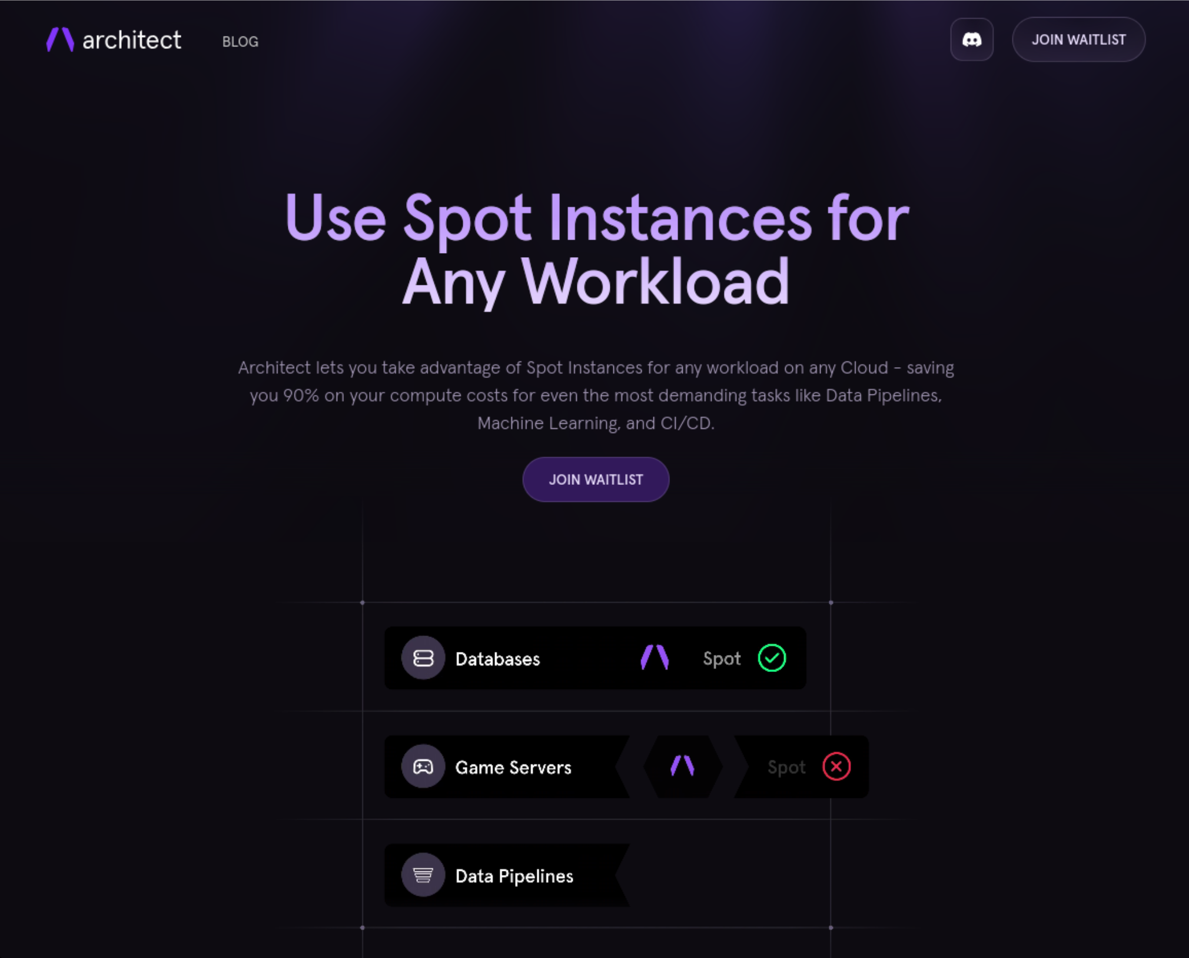



Felicitas
Pojtinger
Fediverse:
Bluesky:
Github:
LinkedIn:
Web:
@pojntfx@mastodon.social
@felicitas.pojtinger.com
@pojntfx in/pojntfx felicitas.pojtinger.com
Waitlist: https://architect.run/
Links & Resources: https://loophole.sh/ bugbash2025
Notes:
If you want to try this out - our public beta is only a few weeks away. There is a waitlist on this QR code [POINT TO SLIDES] that you can sign up for.
Our first integration is a GitHub Actions runner powered by Architect that runs in your cloud account on spot instances. If it gets a preemption notice, it automatically spins up a replacement and migrates to it - completely transparent to end-users.
We also have a working Kubernetes integration and support for more CI/CD providers coming.
And with that I'd like to thank you for listening. I hope that this talk has shown that the future of CI/CD isn't about choosing between cost and reliability anymore - it's about having both, on your terms, across any infrastructure of your choosing.
And if you want to know more, scan the QR code or come chat with me - I'll be here all day!

